Slide 1

Smart Fertilizer Spraying System Using Plant Disease Severity Analysis
Smart Fertilizer Spraying System Using Plant Disease Severity Analysis
by
Y Trinesh Reddy
Roll No. 234G5A3311
G Sreeja
Roll No. 224G1A33A9
B Revathi
Roll No. 224G1A3380
Y Sravani
Roll No. 224G1A33A4
Under the guidance of
Dr. C. Sasikala M.Tech., Ph.D.
Associate Professor
Department of Computer Science and Engineering (AI & ML)
Srinivasa Ramanujan Institute of Technology
(Affiliated to JNTUA & Approved by AICTE) (Accredited by NAAC with ‘A’ Grade & Accredited by NBA (EEE, ECE & CSE)
Rotarypuram Village, B K Samudram Mandal, Ananthapuramu – 515701.
2025 - 2026
B-10
Srinivasa Ramanujan Institute of Technology 1

Slide 2
Contents
Abstract
Introduction
Objectives of Project
Literature survey for objectives
Existing System
Proposed System
Planning
Requirements
UML Diagrams
Data Flow Diagram
Data Preprocessing Techniques
Sample Code
Screenshots (Project Output)
References
GitHub Link
B-10
Srinivasa Ramanujan Institute of Technology
2

Slide 3
Abstract
The Smart Fertilizer Spraying System with Plant Disease Severity Analysis is an automated agricultural robot designed to enhance crop management through precision farming. The system employs a Raspberry Pi equipped with a USB camera to capture plant images and analyze disease severity using advanced image processing techniques. Based on the detected severity levels, the system dynamically regulates fertilizer spraying duration through three dedicated nozzles, ensuring precise application and minimizing wastage.
An Arduino microcontroller manages the operation of DC motors, water pumps, relays, and the robot chassis for efficient movement. Powered by a 12V battery and supported by a 9V solar panel, the system offers sustainable and energy-efficient operation. Bluetooth connectivity facilitates wireless monitoring and control. By combining disease severity detection with intelligent fertilizer management, this system reduces human intervention, optimizes resource utilization, and promotes eco-friendly farming practices
B - 10
Srinivasa Ramanujan Institute of Technology
4

Slide 4
Introduction
The Smart Fertilizer Spraying System with Plant Disease Severity Analysis is an automated agricultural robot developed to improve crop management through precision farming. The system uses a Raspberry Pi integrated with a USB camera to capture plant images and analyze disease severity using advanced image processing techniques. Based on the detected severity levels, the system automatically controls the fertilizer spraying process by adjusting the spray duration through three dedicated nozzles, ensuring accurate application while minimizing fertilizer wastage.
An Arduino microcontroller manages the robot’s movement and controls hardware components such as DC motors, water pumps, relays, and the chassis to enable efficient field navigation. The system is powered by a 12V battery supported by a 9V solar panel, providing sustainable and energy-efficient operation. Bluetooth connectivity allows wireless monitoring and control of the system. By integrating plant disease severity detection with intelligent fertilizer management, the proposed system reduces human intervention, optimizes resource utilization, and promotes eco-friendly and sustainable agricultural practices.
Srinivasa Ramanujan Institute of Technology

Slide 5
Objectives Of Project
To implement plant disease severity analysis using image processing techniques.
To capture real-time crop images using a Raspberry Pi with USB camera.
To classify disease severity levels accurately for effective treatment.
To automatically control fertilizer spraying duration based on detected severity.
To ensure precise fertilizer application using multiple dedicated nozzles.
To reduce fertilizer wastage and prevent environmental damage.
To integrate Arduino-based control for robot movement and hardware operations.
To provide wireless monitoring and control using Bluetooth technology.
To promote eco-friendly, energy-efficient, and sustainable farming practices.
To minimize human intervention in fertilizer spraying operations.
Srinivasa Ramanujan Institute of Technology

Slide 6
Literature Survey
Plant Disease Detection System for Smart Agriculture:
The Indian economy relies on agriculture to a great extent. In traditional agricultural practices, farmers identify crop diseases either through direct visual inspection or by consulting experts, sometimes by sharing diseased crop images through online services. However, continuous monitoring and assessment of disease severity cannot be performed manually, often leading to delayed treatment and increased crop loss.
In the plant disease detection system, the image to be tested is acquired, pre-processed, segmented, and analyzed to determine both the type of disease and its severity level. The classification and severity estimation are performed using a probabilistic linear classifier, namely the Naive Bayes algorithm. The system is developed using Android Studio, and python is used as the programming language.
The application identifies plant diseases based on pixel intensity analysis and evaluates the extent of disease spread (severity) on the affected leaves. Based on the detected severity level, the system predicts plant growth conditions and provides recommendations for appropriate fertilizers and pesticides. The developed system achieves an accuracy and its implementation reduces manpower requirements while improving productivity through timely and severity-based intervention.
.
Srinivasa Ramanujan Institute of Technology
6

Slide 7
Literature Survey
2. Crop Care – An AI-Integrated System for Smart Crop Protection and Disease Detection:
Agriculture plays a vital role in sustaining human life by ensuring food security for a growing population. However, plant diseases and improper fertilizer application often lead to reduced crop yield, economic losses, and environmental damage. To overcome these challenges, Crop Care proposes an AI-integrated automated agricultural robot designed to detect plant disease severity and perform precision fertilizer spraying without direct human intervention.
The system utilizes a Raspberry Pi integrated with a USB camera to capture real-time images of crops and analyze disease severity using advanced image processing and machine learning techniques. Based on the identified severity level, the system automatically regulates fertilizer spraying duration through three dedicated nozzles, ensuring accurate application while minimizing fertilizer wastage.
An Arduino microcontroller is employed to control the robot’s movement and manage hardware components such as DC motors, water pumps, relays, and the chassis, enabling efficient navigation across the field. The system is powered by a 12V battery supported by a 9V solar panel, ensuring energy-efficient and sustainable operation. Additionally, Bluetooth connectivity enables wireless monitoring and control of the robot.
By combining plant disease severity detection with intelligent and automated fertilizer management, the proposed system significantly reduces human effort, optimizes resource utilization, prevents overuse of fertilizers, and supports eco-friendly and sustainable farming practices.
Srinivasa Ramanujan Institute of Technology

Slide 8
Existing System
Traditionally, crop health monitoring and fertilizer application rely on manual inspection, where farmers visually examine plants to identify diseases, pests, or nutrient deficiencies and then apply fertilizer or pesticides using hand-operated or tractor-mounted sprayers.
This approach is labor-intensive, time-consuming, and prone to human error, often resulting in under- or over-application of chemicals. Additionally, uniform spraying without considering disease severity leads to wastage of resources and potential environmental harm. Compared to this traditional method, automated systems that integrate disease severity detection with targeted fertilizer application offer greater efficiency, accuracy, and sustainability.
Srinivasa Ramanujan Institute of Technology

Slide 9
Proposed System
The proposed Smart Fertilizer Spraying System integrates plant disease severity detection with precision fertilizer application to optimize crop management. The system uses a Raspberry Pi equipped with a USB camera to capture real-time images of plants. Image processing techniques are applied to analyze these images and determine the severity of detected diseases. Based on the severity level, the system intelligently adjusts the spraying duration of three separate nozzles, ensuring precise fertilizer application and minimizing waste.
An Arduino microcontroller controls the movement of the robot chassis, DC motors, water pumps, and relays to execute spraying operations efficiently. The system is powered by a 12V battery and supported by a 9V solar panel for sustainable operation. Bluetooth communication enables wireless monitoring and control, allowing farmers to track system performance and adjust settings remotely. This approach reduces human intervention, improves crop health, and promotes eco-friendly farming practices.
Srinivasa Ramanujan Institute of Technology

Slide 10
Planning
Study of plant diseases and the importance of severity-based fertilizer application
Design of an automated agricultural robot to eliminate direct human intervention.
Selection of Raspberry Pi with USB camera for image acquisition and disease severity analysis.
Implementation of image processing techniques to classify disease severity levels.
Integration of Arduino for controlling DC motors, pumps, relays, and robot movement.
Development of a severity-based fertilizer spraying mechanism using three dedicated nozzles.
Integration of Bluetooth communication for wireless monitoring and control.
Design of a solar-assisted power system using a 12V battery and 9V solar panel for energy efficiency.
Testing and validation of system performance in real-time field conditions.
B-10
Srinivasa Ramanujan Institute of Technology

Slide 11
Requirements
Software Requirements
Operating System: Raspberry Pi OS, Windows 10/11
Languages: Python, Embedded C
IDE / Tools: Arduino IDE, Thonny / VS Code
Libraries: OpenCV, NumPy
Communication: Bluetooth (Serial)
Hardware Requirements
Controllers: Raspberry Pi, Arduino
Camera & Memory: USB Web Camera, Micro SD Card
Power Supply: 12V Battery, 9V Solar Panel, 12V Adapter (2A)
Motors & Actuators: DC Motors (2), DC Water Pumps (3)
Control Modules: Motor Driver, Relays (3), Bluetooth Module
Mechanical Setup: Robot Chassis, Wheels (4), Dummy Shafts (2)
Spraying System: Nozzles (3), Plastic Boxes
Others: LEDs, Slide Switch
B-10
Srinivasa Ramanujan Institute of Technology

Slide 12
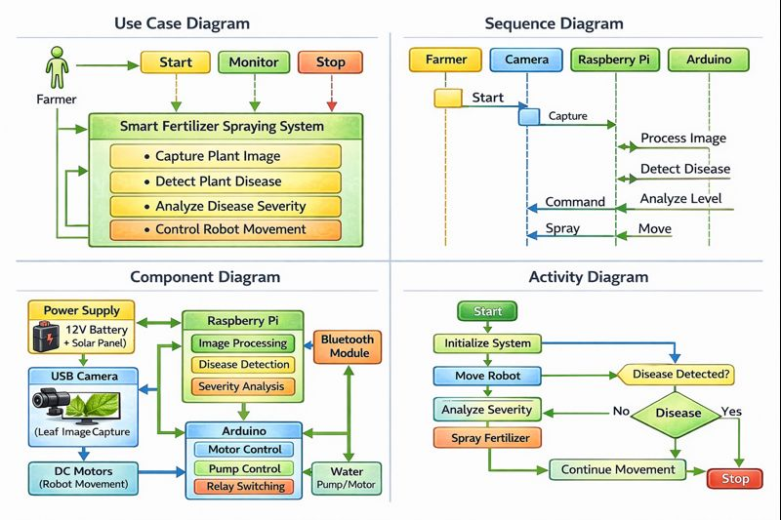
UML Diagrams
Srinivasa Ramanujan Institute of Technology

Slide 13
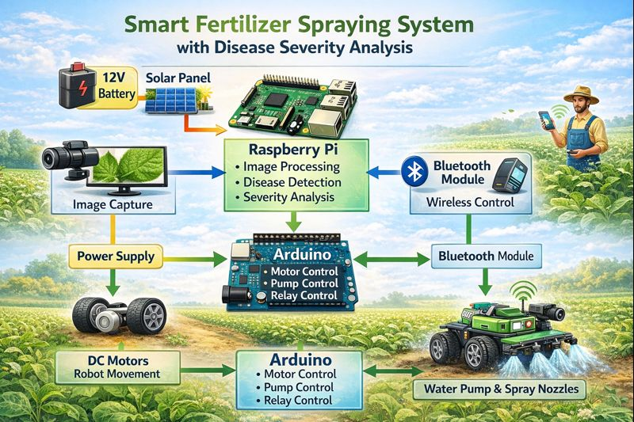
Data Flow Diagram
Srinivasa Ramanujan Institute of Technology

Slide 14
Data Preprocessing Techniques
Image Resizing Captured leaf images are resized to a fixed resolution to reduce processing time and ensure uniform input.
Noise Removal Filters such as Gaussian or Median filters are applied to remove noise caused by dust, lighting, or camera disturbances.
Image Enhancement Contrast enhancement techniques are used to highlight disease-affected regions on the leaf surface.
Color Space Conversion RGB images are converted to HSV or LAB color space for better separation of disease colors from background and lighting effects.
Image Segmentation The leaf region is separated from the background using thresholding or color-based segmentation to focus analysis on infected areas.
Image Normalization Pixel intensity values are normalized to a standard range to improve consistency and accuracy during disease analysis.
Feature Extraction Important features such as color, texture, and shape are extracted from the processed image to identify disease severity levels.
Srinivasa Ramanujan Institute of Technology

Slide 15
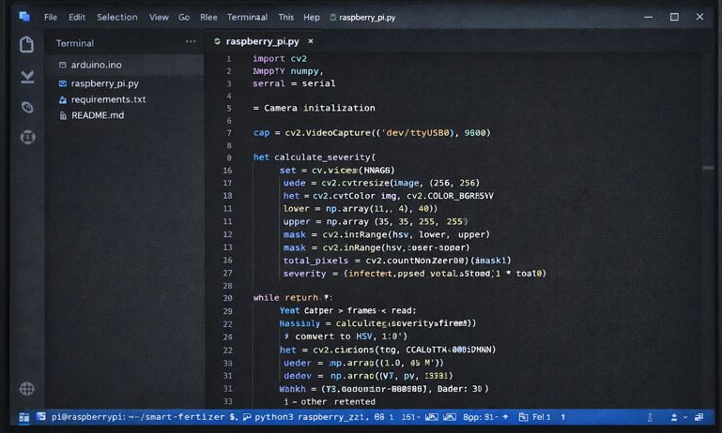
Sample Code
Srinivasa Ramanujan Institute of Technology

Slide 16
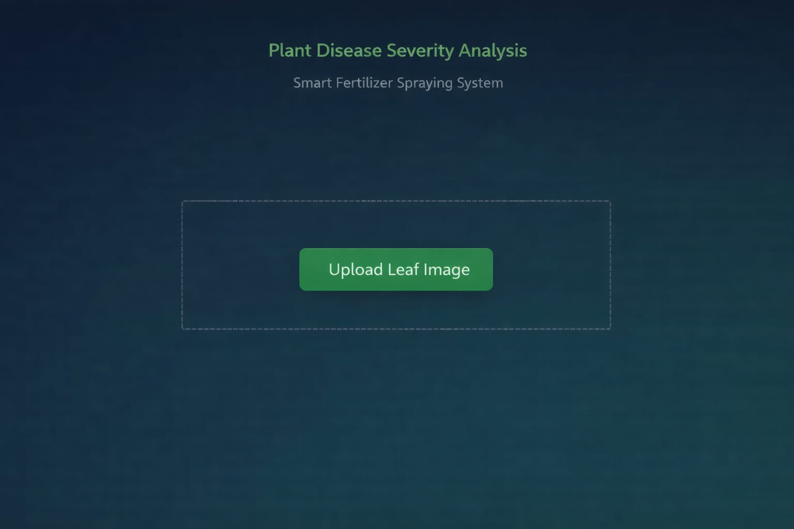
Screenshots(Project Output)
Srinivasa Ramanujan Institute of Technology

Slide 17
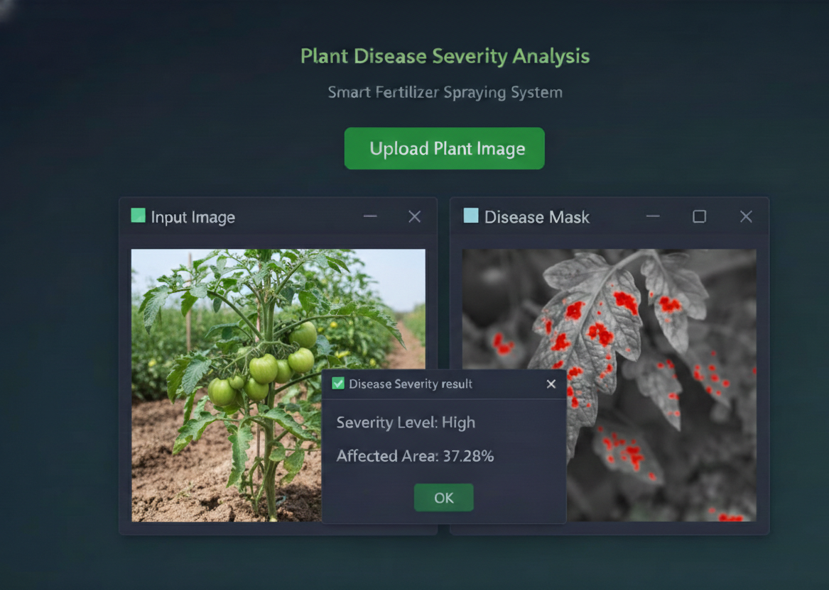
Screenshots(Project Output)
Srinivasa Ramanujan Institute of Technology

Slide 18
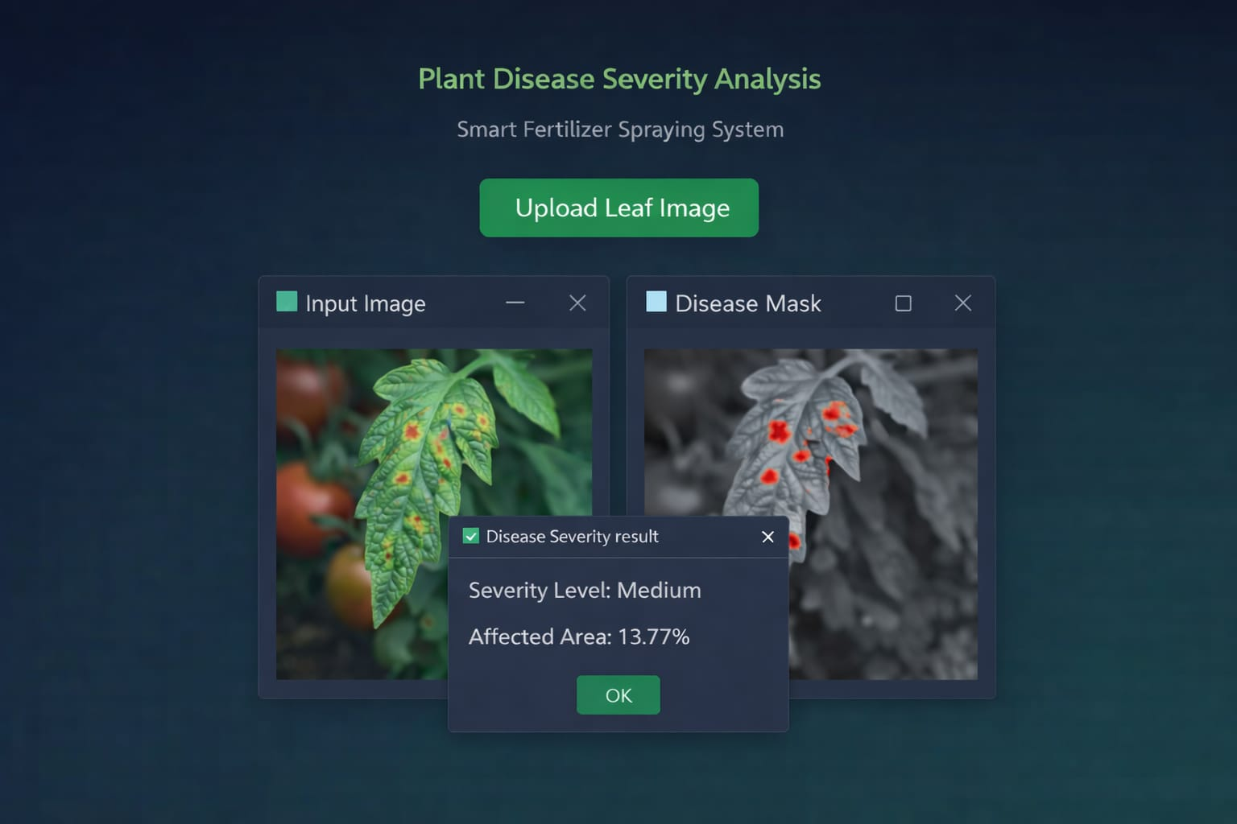
Screenshots(Project Output)
Srinivasa Ramanujan Institute of Technology

Slide 19
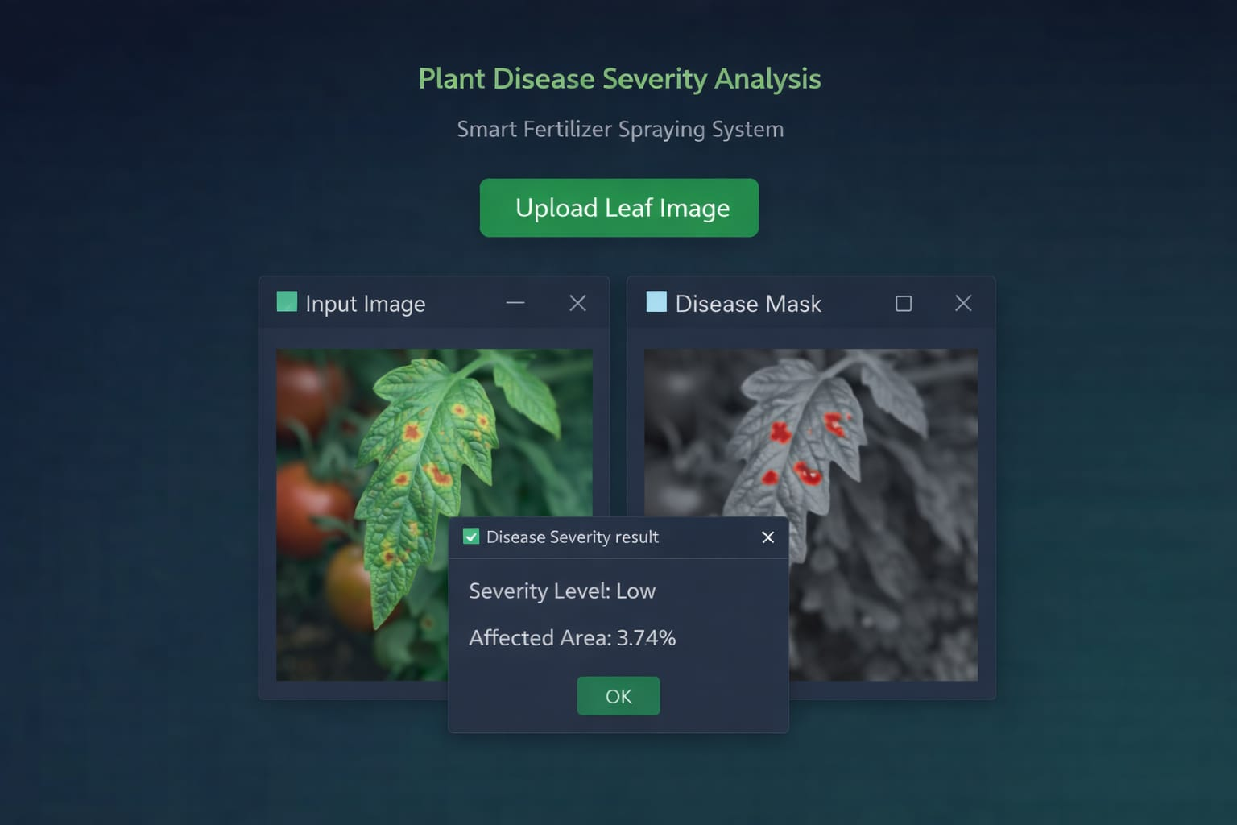
Screenshots(Project Output)
Srinivasa Ramanujan Institute of Technology

Slide 20
Reference
Prakash M. Manikar, Shreekant Ghorpade, Mayur Adawadkar, "Plant Leaf Disease Detection and Classification Using Image Processing Techniques," International Engineering Journal, Volume 2, Issue 4, 2015.
2 Prof. Bhavana Patil, Mr. Hemant Panchal, Mr. SHUBHAM Yadav, Mr. Arvind Singh, Mr. Dinesh Patil, "Plant Monitoring Using Image Processing, Raspberry PI and IOT," Journal of Engineering and Technology, Volume 4, Issue 10, 2017
3 Navin V. Dumare, Prof. S. S. Mungona, "Identification of Cotton Leaf Diseases Using Raspberry PI," Volume 5, Issue 5, 2017, International Journal on Recent and Technology Trends in Computing and Communication.
Prathamesh. K. Kharde, Hemangi. H. Kulkarni, "A Special Method for the Detection of Grape Leaf Diseases," International Journal of Scientific Research, Volume 2, Issue 4, 2016.
Jayaprakash Sethupathy, Veni S, International Journal of Engineering and Technology, Volume 8, No 5, 2016, "Open CV Based Disease Detection of Mango Leaves."
Srinivasa Ramanujan Institute of Technology

Slide 21
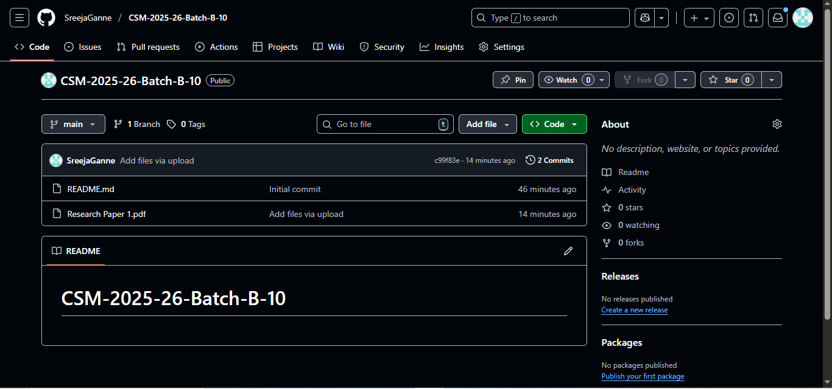
Git Hub Dashboard
Srinivasa Ramanujan Institute of Technology

Slide 22
Any Queries?
Srinivasa Ramanujan Institute of Technology

Slide 23
Thank You!!!
Srinivasa Ramanujan Institute of Technology

